Slide 1
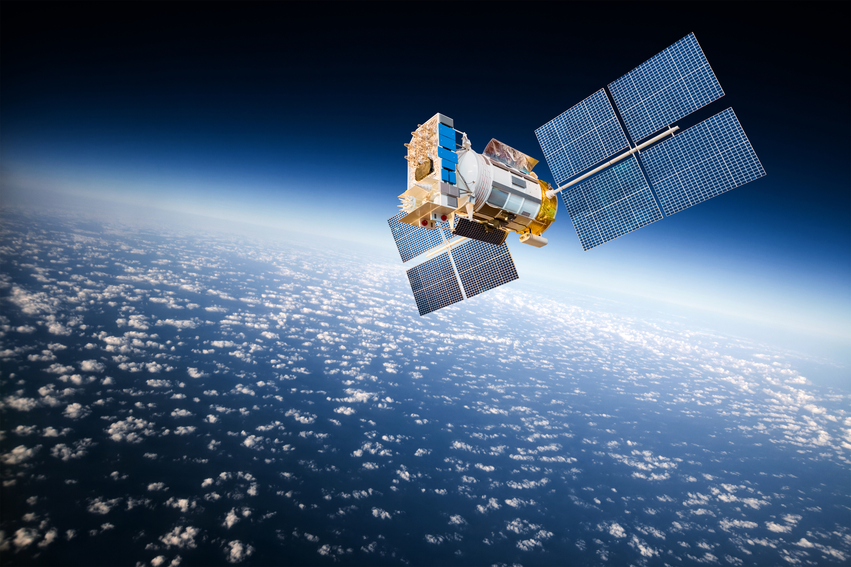


Sophie Fabre
Rollin Gimenez
Léa Camusat
Eva Etheve Julie Gonzalez
Lila Roig
PIR Presentation
Rejection method for supervised classification of plant species from passive optical remote sensing data
2021-2022
4Y - GMM
06.01.22
Notes:
Insa logo
company logo onera
Tutors
Author
Title
date
Yer of study + departtement
Pir presentation

Slide 2
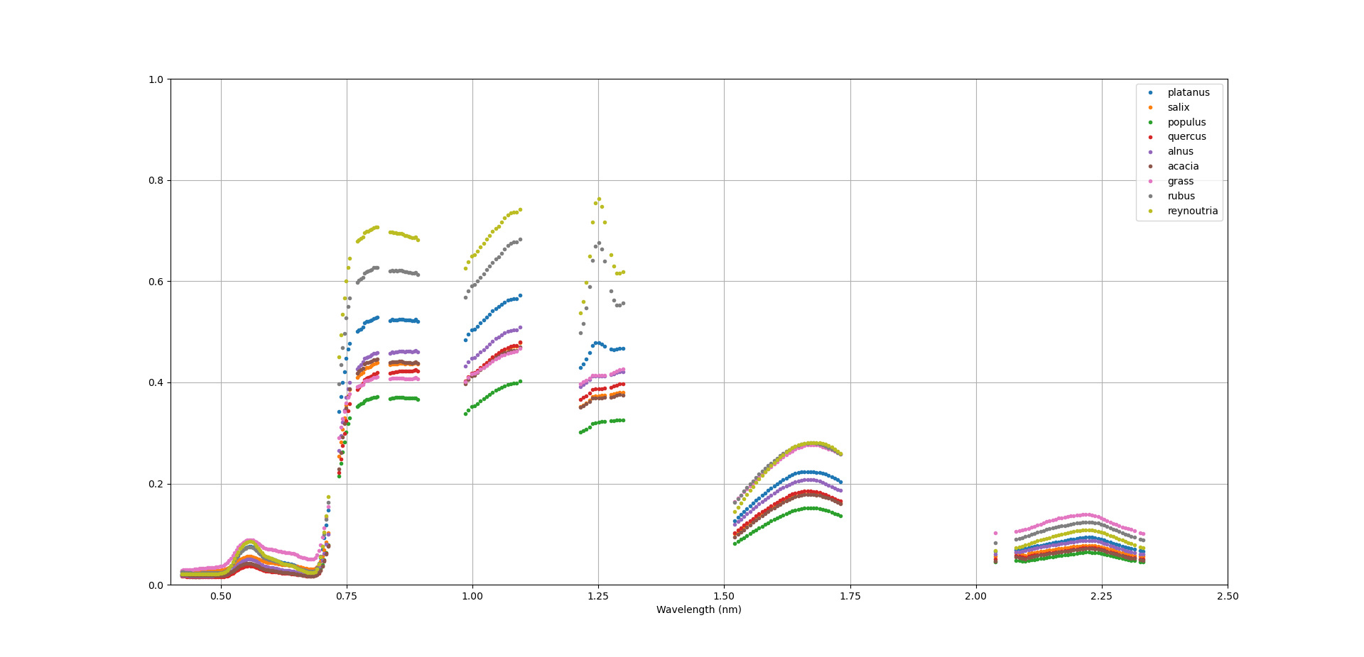
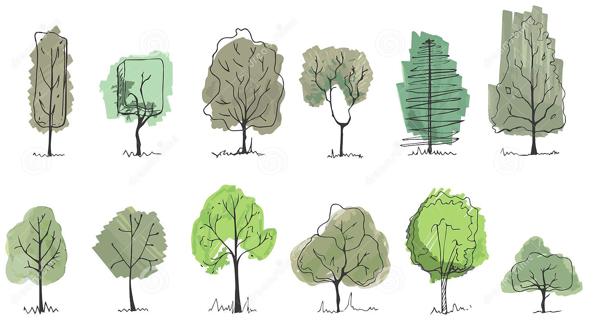
Plant species identification Essential for biodiversity analysis → Optical remote sensing
Classification of plant species from the satellite image based on the spectrum of each plant species
Necessity of a trade-off between the risk-coverage and accuracy
→ Reject option [El-Yaniv and Wiener, 2010]
No efficient post-rejection algorithm has been developed yet for hyperspectral and multispectral images.
OBJECTIVE: Apply rejection methods post classification on the probability vectors, considering novelty and ambiguity rejection
2
Notes:
Savoir définir les keywords

Slide 3
2
2
Implementation of methods:
- Training set and context
- Rejection class
4
4
Conclusion et perspectives
1
3
1
3
Description of the data
Results: Performance and comparison of approaches
3

Slide 4
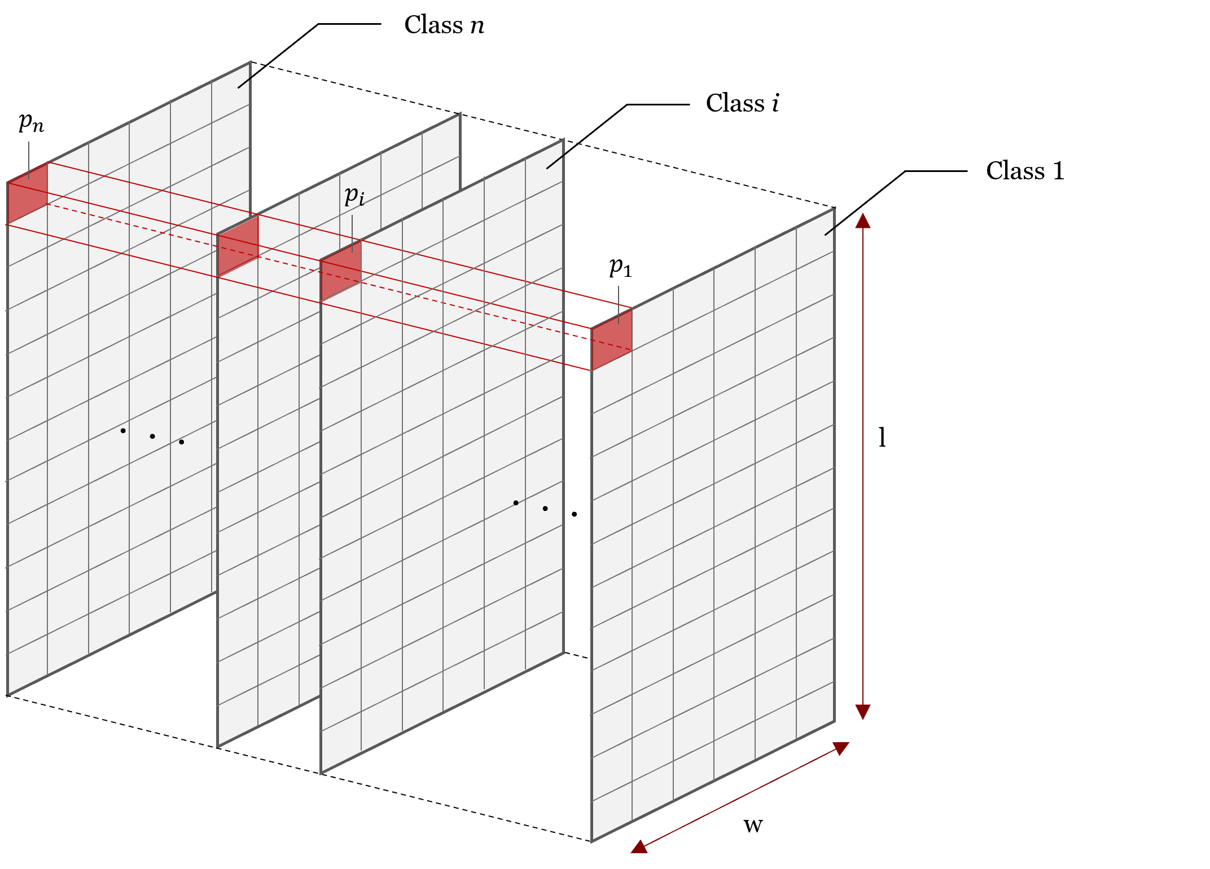
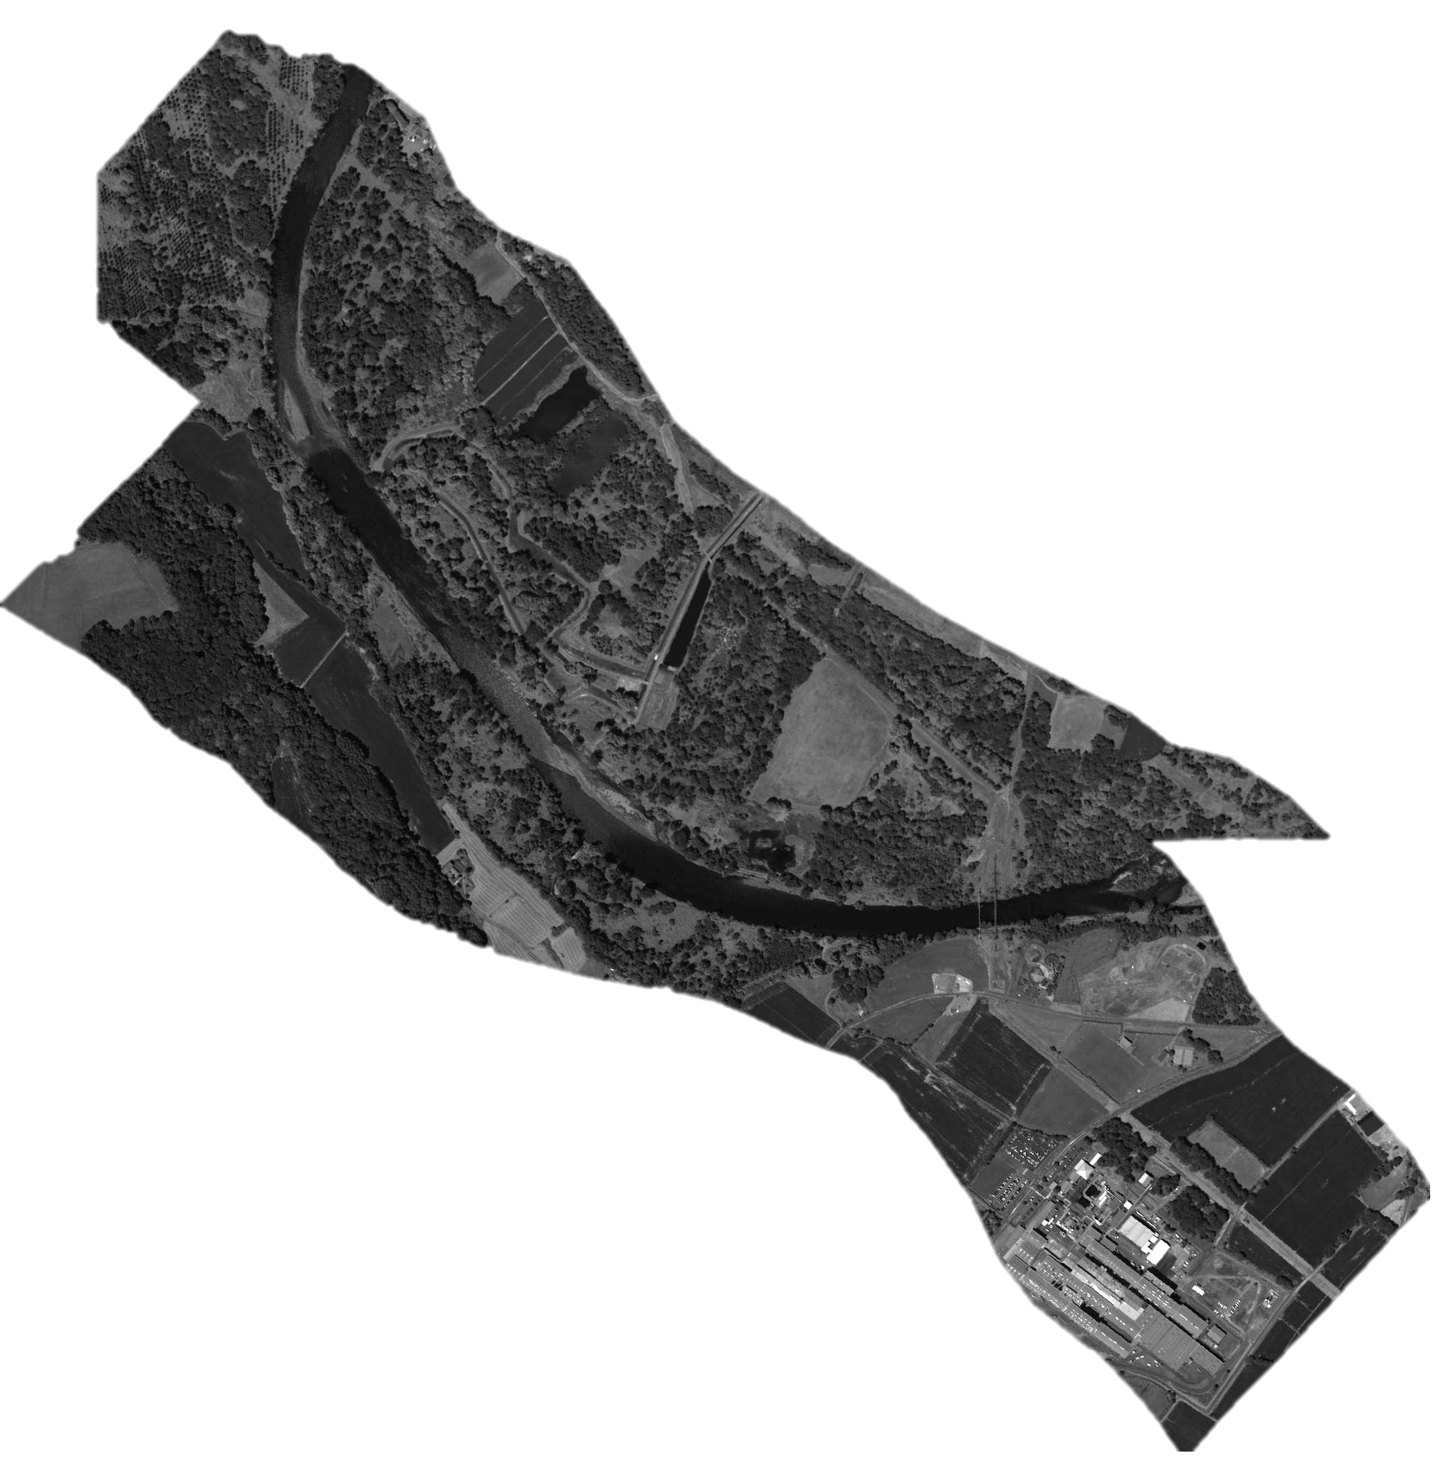

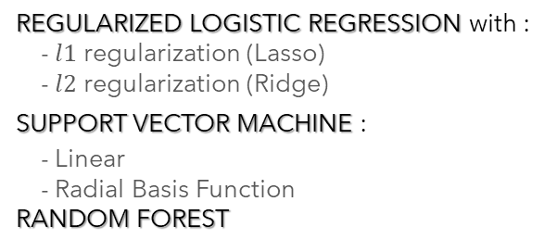
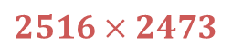
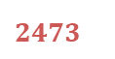
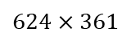
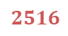
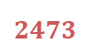
1
Description of the data
$$ℙ(pixel∈class i)$$
$624×361$
$$2516$$
REGULARIZED LOGISTIC REGRESSION with :
- $l1$ regularization (Lasso)
- $l2$ regularization (Ridge)
SUPPORT VECTOR MACHINE :
- Linear
- Radial Basis Function
RANDOM FOREST
$2473$
Matrix of probabilities
$2516×2473$
Class number of the pixel
$$2516$$
10 species
Platanus
Salix
Populus
Quercus
Alnus Robinia
Grass Shrubs mixtures
Reynoiutria
Corn crops
$2473$
Matrix of classes
4

Slide 5

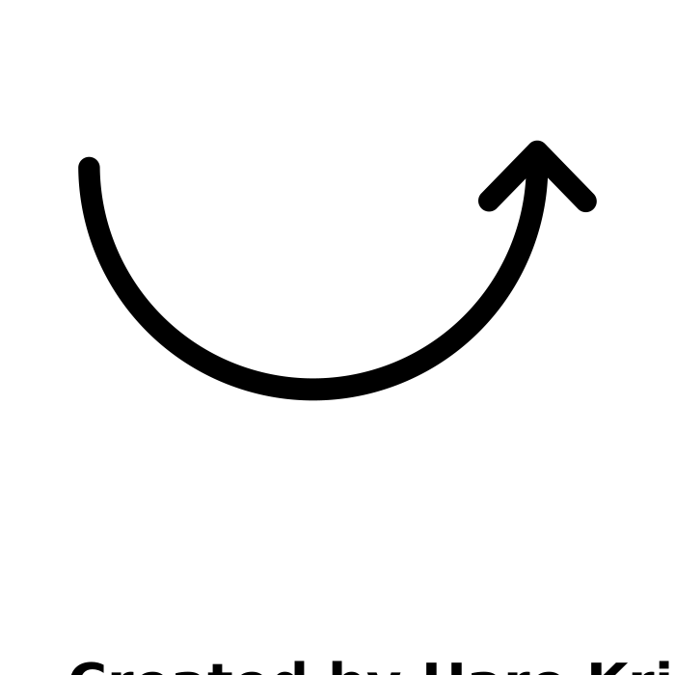
2
Methods
Processing of data & Evaluation methods
1. Before classification:
Training set and test set
2. After classification and rejection: Context
3 categories of pixels:
Shadow pixels
Pixels well classified
Pixels wrongly classified
Objective:
Improve the results of the rejection algorithm
Classified in class n°1
2 rules to build the training set:
Probability > 0.5
+ difference between the two highest probabilities > threshold
Same class given by several algoritms
Size of the neighbourhood around the pixel p
1 | 1 | 1
R | p | 1
R | R | 1
Probability vector of a pixel
Rejected
0.6 | 0.3 | 0.02 | 0.005 | 0.04 | 0.01 | 0.01 | 0.02 | 0.01 | 0.05
5

Slide 6
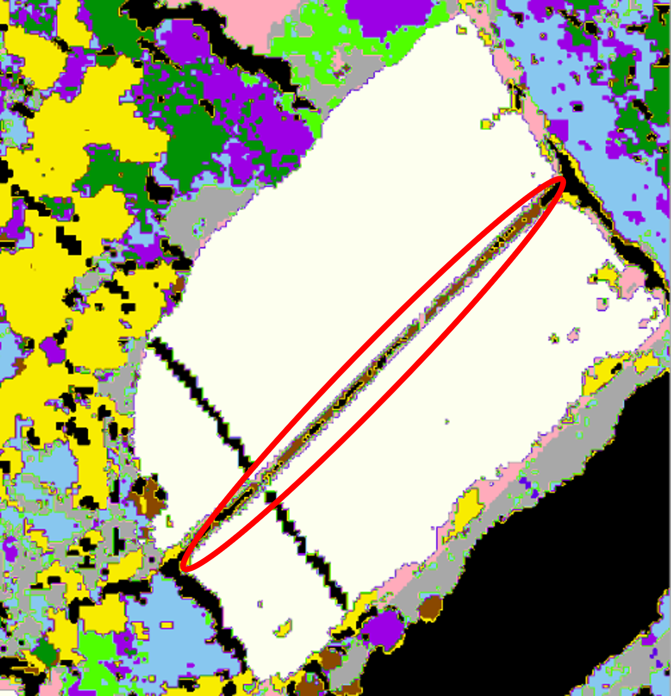
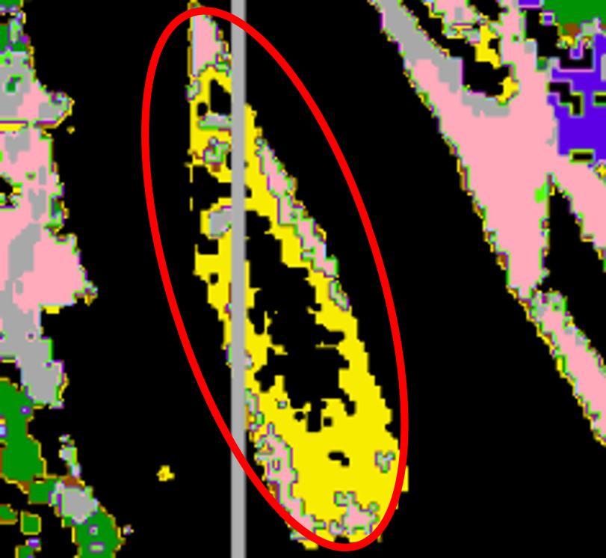
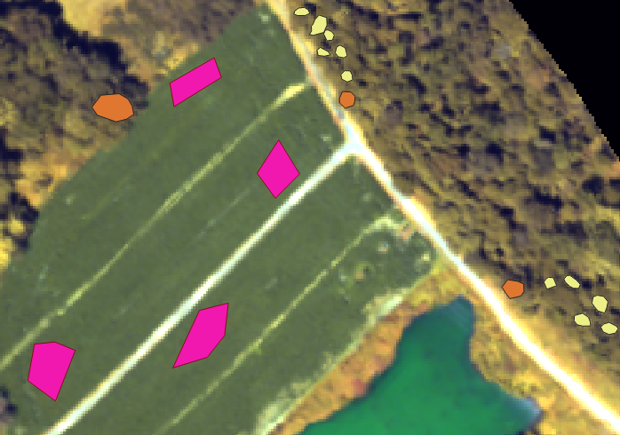
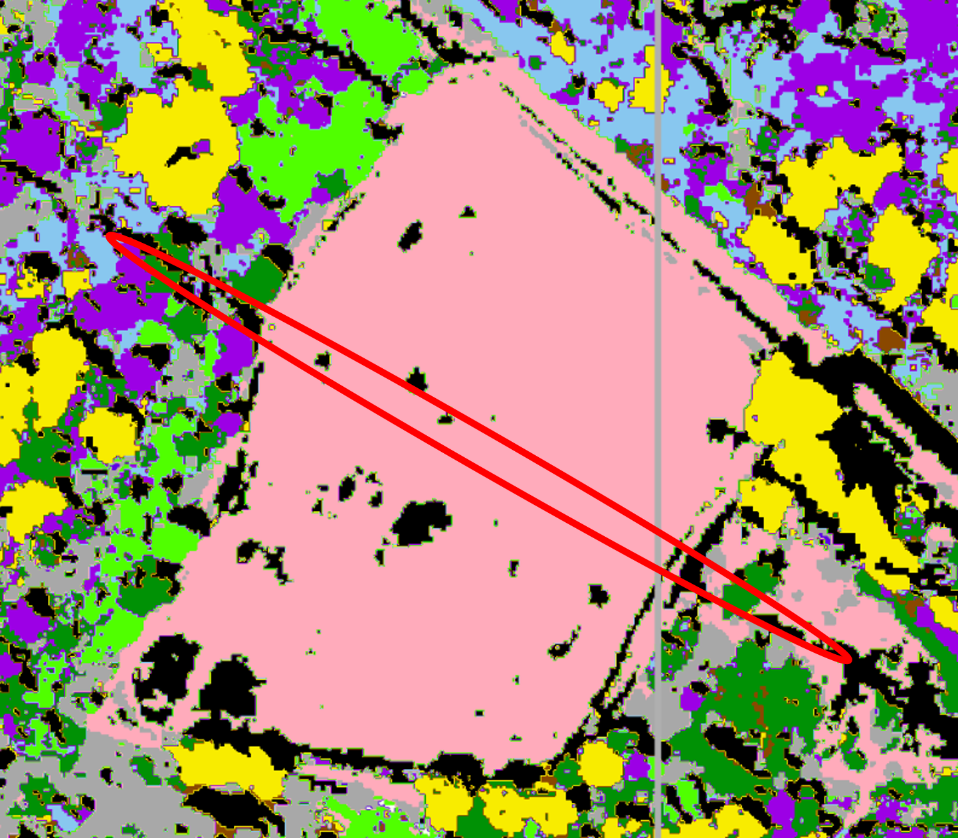
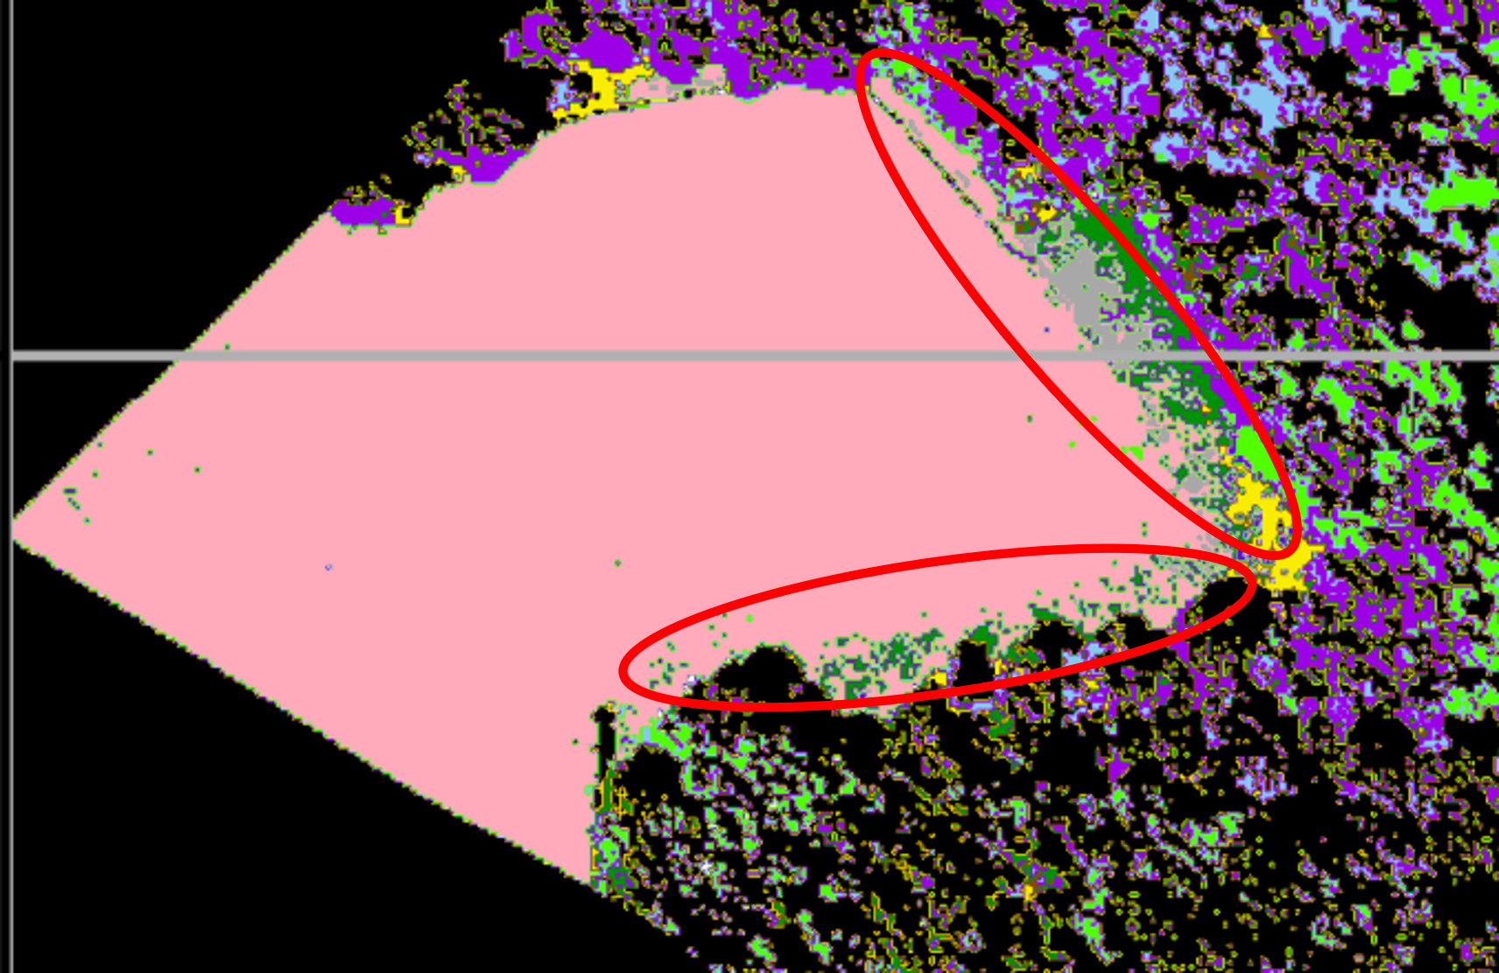
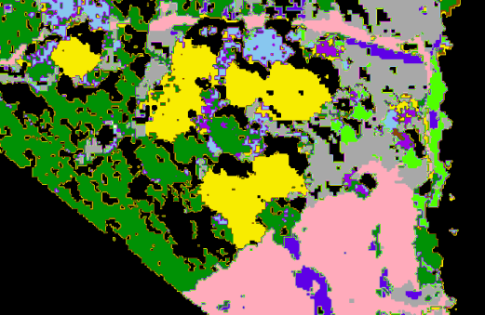
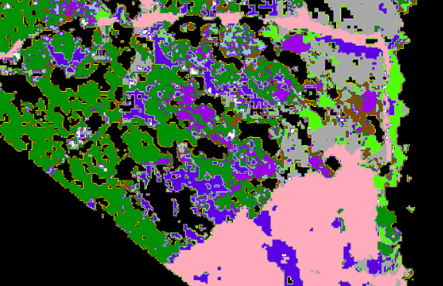
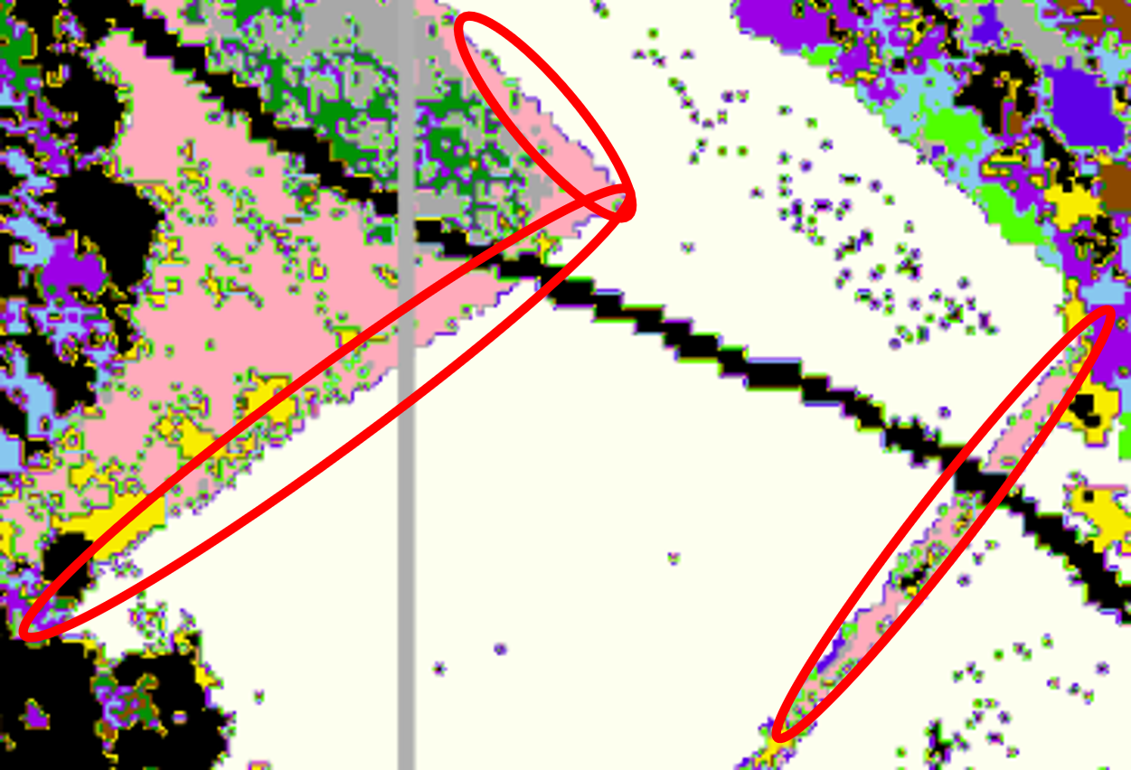

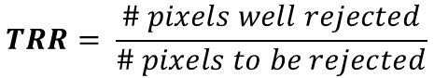
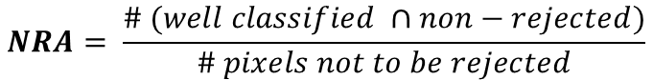
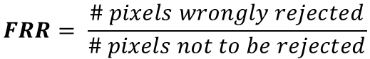
2
Methods
Processing of data & Evaluation methods
-A- Visual assessment : areas of interest
-B- Labelled data
$$NRA= \frac{\# (well classified ∩non−rejected)}{\# pixels not to be rejected}$$
$$TRR= \frac{\# pixels well rejected}{\# pixels to be rejected}$$
$$FRR= \frac{\# pixels wrongly rejected}{\# pixels not to be rejected}$$
Dirt road
Island
Labelled polygons
-C- Delete one class in the initial dataset and check if the pixels are rejected
Electricity line
Fallow land
Plane tree
Rejected points ?
Borders between species
6

Slide 7






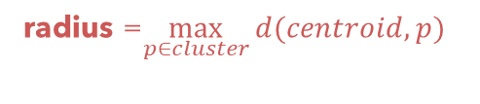
2
Methods
K-means
Unsupervised partitioning-based algorithm
Advantages
Predicts new data
Drawbacks
Needs to know the number of clusters K in advance
Cannot detect outliers
1. Build 10 clusters on the training data
2. Compute each cluster’s radius
3. Prediction and rejection :
Unclassified pixel p rejected
centroid
R x T
R
Unclassified pixel p belonging to the cluster
p
T : Threshold to be calibrated
Minimize distances to clusters’ center
radius =$\max_{p∈cluster}{d(centroid, p)}{ }$
Determine whether the pixels of the test set should be classified in a cluster or rejected
7

Slide 8
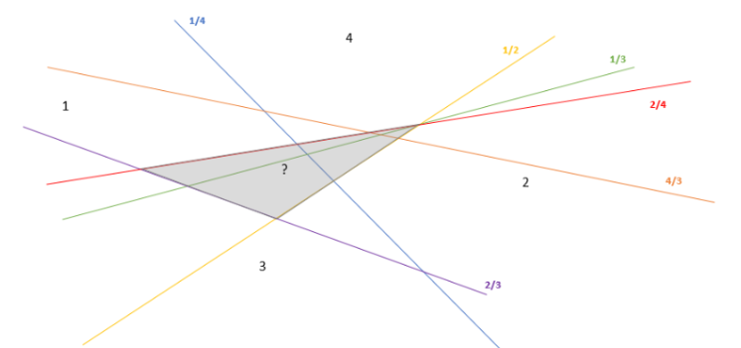
2
Methods
SVM
Supervised algorithm of classification
[Djeffal, 2012] [Grandvalet et al., 2008]
hyperplane
→ Hypothesis
Dataset supposed linearly separable
extension to multi-classification
→ Principle:
Optimization of hyperplanes in OVO (One vs One) & OVR (One vs Rest)
→ Rejection method for the pixel:
Highest relative difference of decision function < median or 3rd quartile of these relative differences
𝛾
𝛾
Undecision area in OVO
Binary classification SVM
8

Slide 9
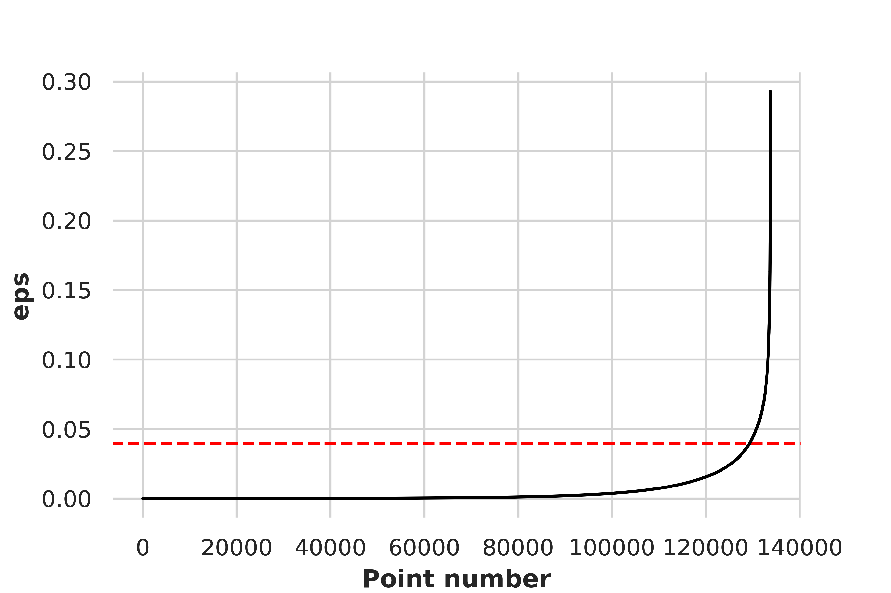



2
Methods
DBSCAN
Density-based Spatial Clustering Of Applications With Noise
Advantages
Does not need to know labels in advance
Detects outliers
eps
A et B are neighbors if the distance between them is not higher than eps
min_sample
Min number of neighbors A must have to be considered as a core point (A included)
Parameters
C
A
D
A
B
eps
E
B
metric
Min_sample = 3
How to evaluate the distance?
B
A
d(A,B)
9

Slide 10
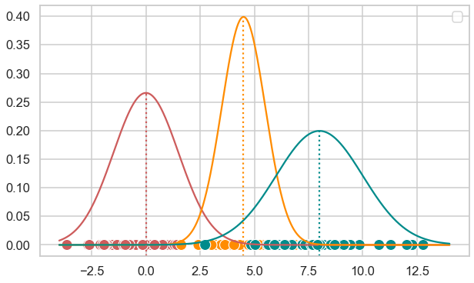

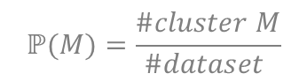
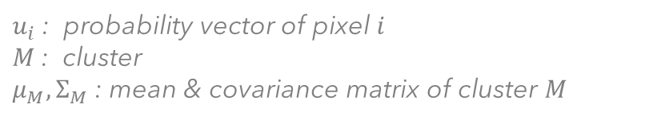
2
Methods
GMM
Unsupervised probability-based algorithm
1. The elements of each cluster follow a gaussian distribution
2. Apply a clustering algorithm on non-shadow pixels
Cluster 2
3. Reject option based on a modified GMM algorithm :
Pixel $i$ has been classified to cluster $M$
Cluster 1
$\text{Likelihood}\text{ : }ℙ\left(u_{i} | M\right)$ $\sim N\left(μ_{M},Σ_{M}\right)$
Cluster 3
$u_{i}$: probability vector of pixel $i$
$M$: cluster
$μ_{M},Σ_{M}$: mean & covariance matrix of cluster $M$
$$\text{Probability}\text{ : }ℙ\left(M | u_{i}\right)=\frac{ℙ(u_{i}|M)ℙ(M)}{\sum_{\left\{m∈clusters\right\}}{ℙ\left(u_{i} | m\right)ℙ\left(m\right)}}$$
$$ℙ(M)=\frac{\#cluster M}{\#dataset }$$
Gives poor Results
• Classification of probability vectors
• No selection of well-classified pixels
If $ℙ\left(M | u_{i}\right)$ $< T$ ⇒ we reject $i$ as an outlier
Cluster the data again
10

Slide 11
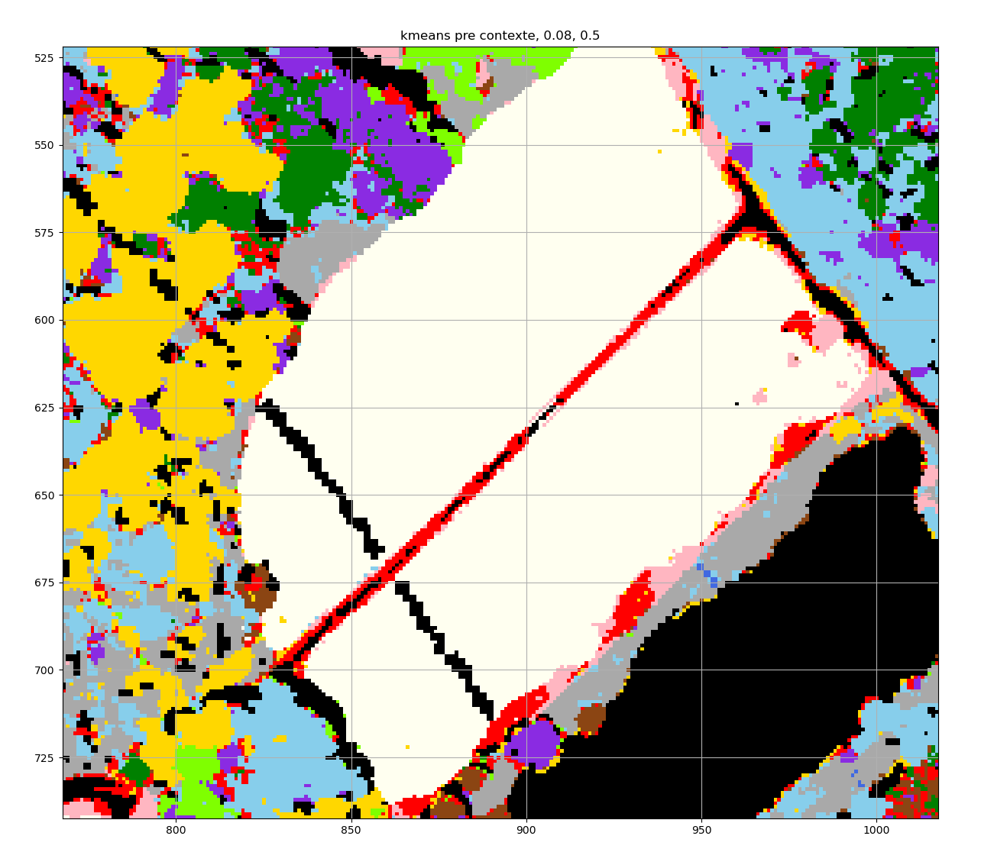
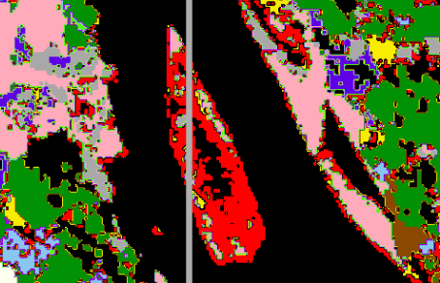
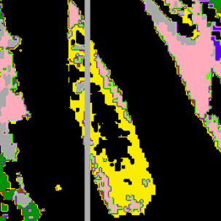
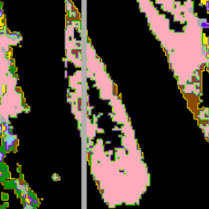
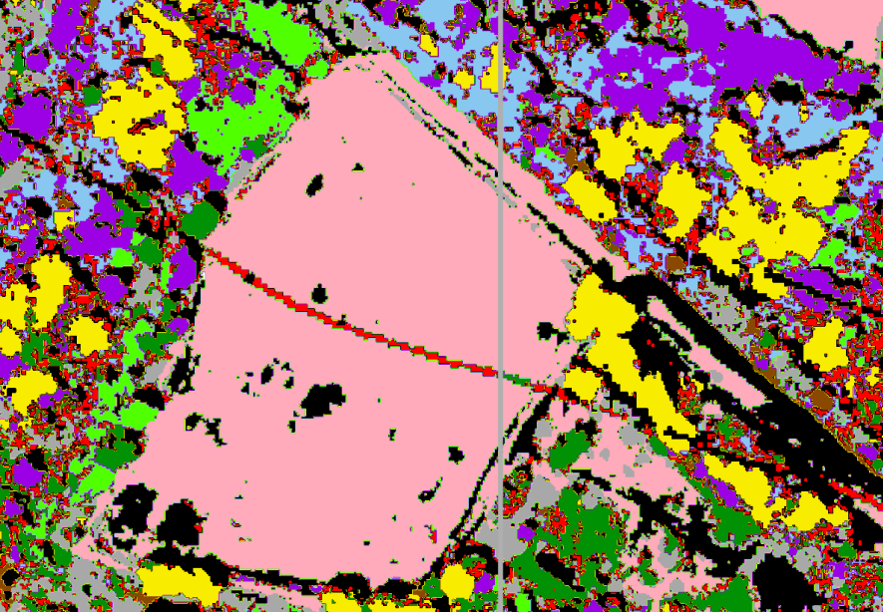
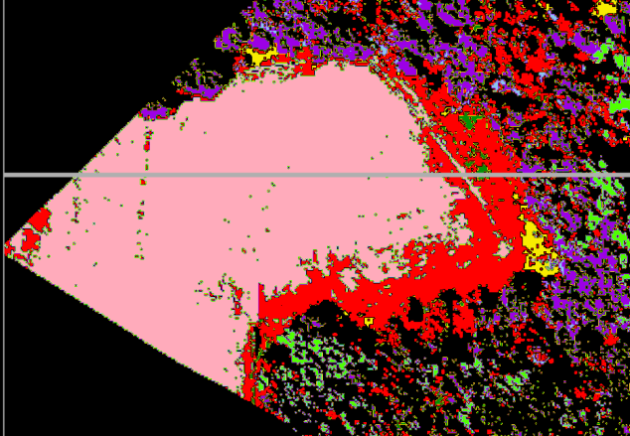
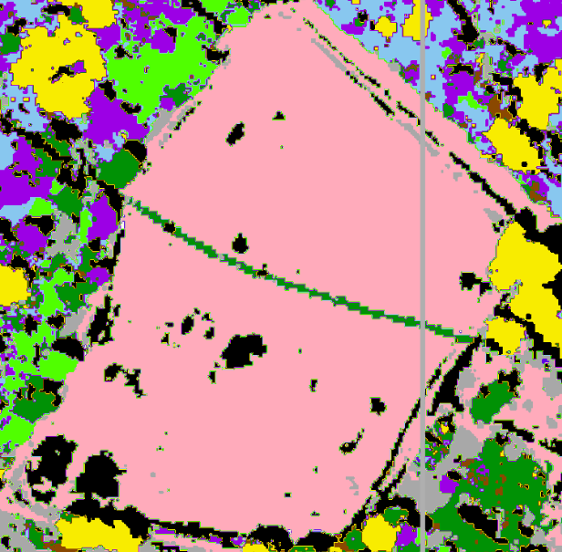
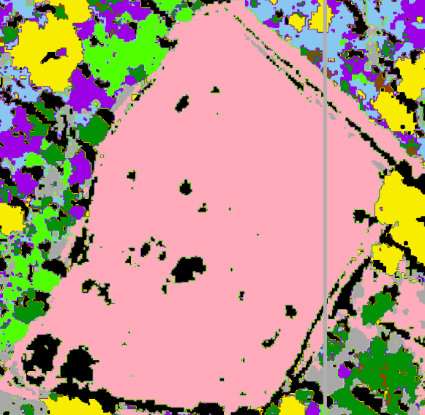
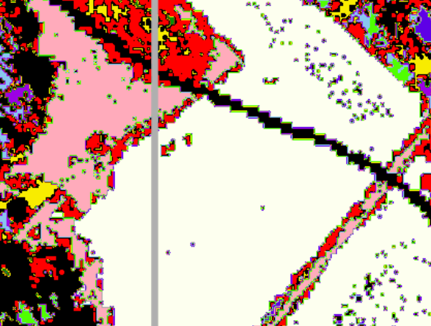
3
Results
K-means
-A- Visual Assessment
Why are the areas of interest sometimes not rejected ?
Grass mixtures ≈ grass present on the island in reality
ISLAND
Dirt road
Island
Island RLR l1
rejected
Island RF
not rejected
Electricity line
Fallow land
Poplar tree: mistake of RLR l2 classification
ELECTRICITY LINE
Electricity Line RLR l2
rejected
Electricity Line RLR l1
not rejected
→ strongly dependant on the initial datasets given by the first classification algorithms
Borders between species
11

Slide 12
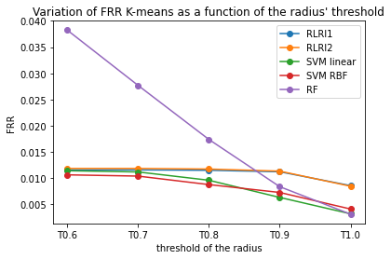
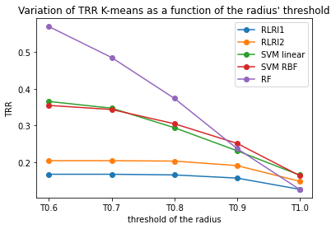


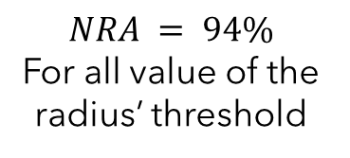
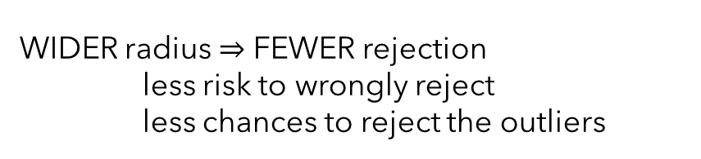
3
Results
K-means
-B- Labelled polygons
NRA
FRR
TRR
$$NRA = 94\%$$
For all value of the radius’ threshold
FRR when the threshold
TRR when the threshold
WIDER radius FEWER rejection
less risk to wrongly reject
less chances to reject the outliers
12

Slide 13
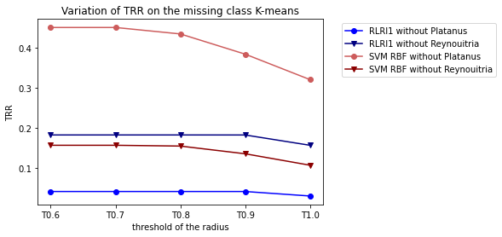
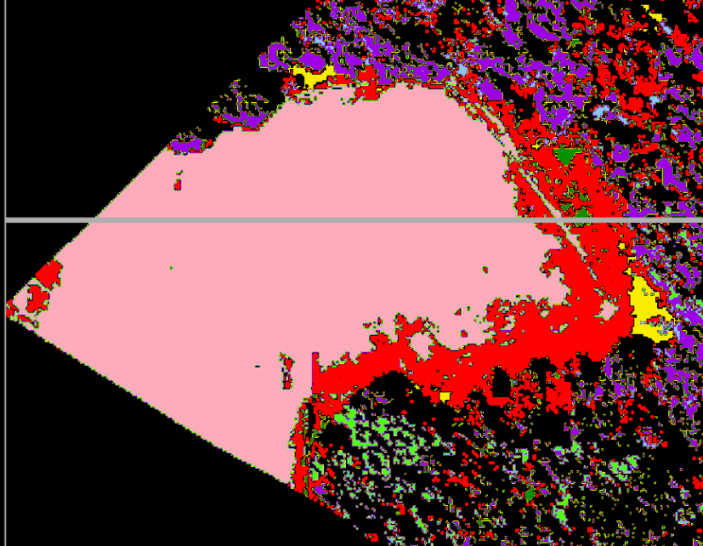

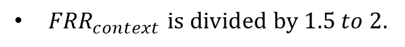
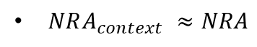
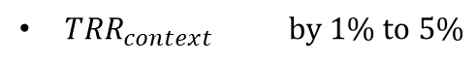
3
Results
K-means
-B- Labelled polygons with context
-C- Missing class
$NRA_{context} ≈NRA$
Inconsistent results:
TRR varies from 3% to 45%
${TRR}_{context}$ $by 1\% to 5\%$
${FRR}_{context}$ $is divided by 1.5 to 2.$
without context
with context
SMOOTHER image
13

Slide 14
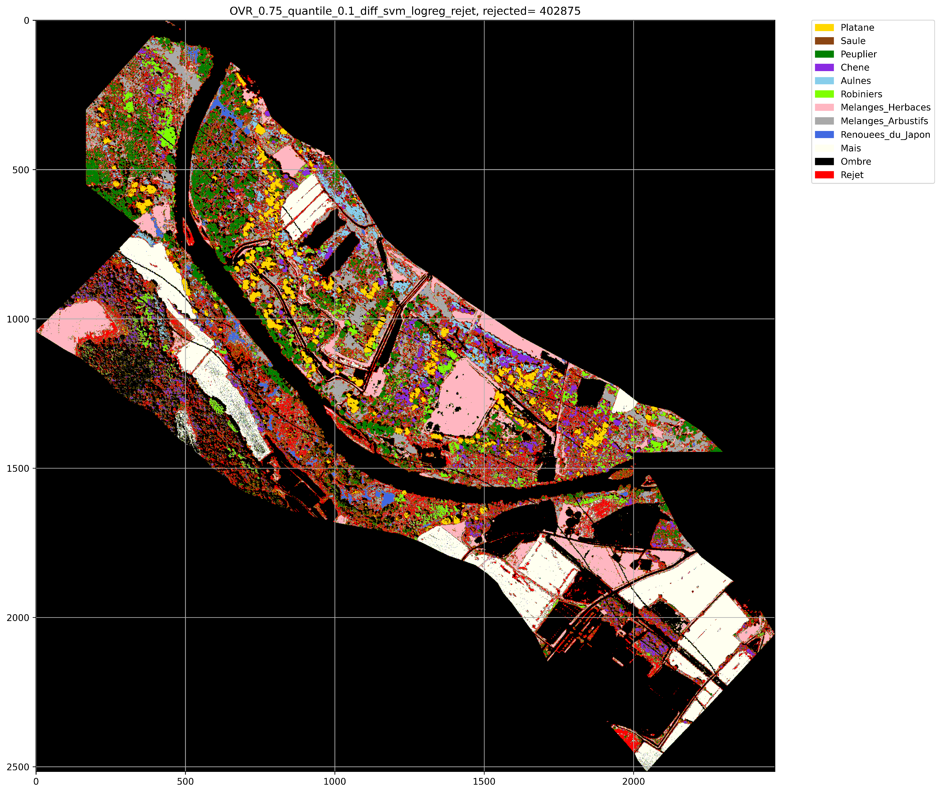


3
Results
SVM
-A- Visual Assessment
-B- Labelled polygons
 | OVO
3rd quartile
SVM2 | 0.27 | 0.01 | 0.94 | 0.33
RLR l2 | 0.14 | 0.01 | 0.94 | 0.11
RF | 0.46 | 0.04 | 0.92 | 0.53
RLR l1 | 0.11 | 0.01 | 0.94 | 0.09
SVM1 | 0.27 | 0.01 | 0.95 | 0.40
Dirt road
Island
Electricity line
Borders between species
TRR, FRR, NRA, STRR (Specific Rejection Rate)
FRR < 4%
NRA > 90%
53% > TRR > 8%
SVM OVR 0.75 quartile (dataset obtained with 0,1 difference on SVM/logreg)
Fallow land
14

Slide 15
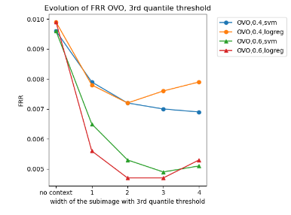
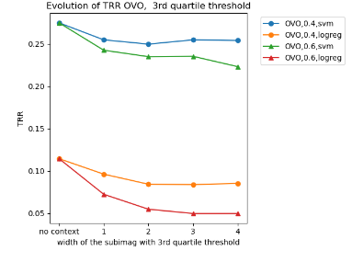
3
Results
SVM
-B- Labelled polygons with context
FRR OVO rejection threshold based on the 3rd quartile
-C- Missing class
Subimage width < 2
Smoother image
 | OVO
3rd quartile
 |  | TRR | FRR | NRA | STRR
SVM1 without Plane tree | 0.27 | 0.24 | 0.01 | 0.90 | 0.31
RLR1 without Plane tree | 0.14 | 0.05 | 0.03 | 0.88 | 0.01
SVM1 without Japanese knotweed | 0.46 | 0.12 | 0.01 | 0.93 | 0.08
RLR1 without Japanese knotweed | 0.11 | 0.19 | 0.01 | 0.92 | 0.35
TRR OVO rejection threshold based on the 3rd quartile
Low impact on TRR
NRA
15

Slide 16






3
Results
DBSCAN
-A- Visual Assessment
Borders between species
Metric
(% of rejected pixels)
Cosine (0.2%)
Correlation (0.2%)
Euclidean (32%)
Cityblock (40%)
Manhattan (37%)
-B- Labelled polygons
-C- Missing class
Metric | Euclidean | Cityblock | Braycurtis | Manhattan | Minkowski | Euc. without Plane tree
FRR | 0.24 | 0.29 | 0.20 | 0.29 | 0.21 | 0.13
NRA | 0.03 | 0.03 | 0.03 | 0.03 | 0.03 | 0.42
16

Slide 17

4
Conclusion et perspectives
SVM
DBSCAN
GMM
K-means
GMM
Two steps:
Construction of a training set of almost-sure well-classified pixels
Rejection step: reclassify or reject pixels
Main features:
Adapted to the detection of outliers
Choice of the parameters
Two steps:
Clustering all non-shadow pixels with GMM of K-means
Implement a rejection method based on GMM
Visual assessment:
Boundaries and some areas of interest
Strongly depends on the first classification
Visual assessment:
- Boundaries
Best results:
TRR = 57 %
FRR = 0.5-1 %
NRA = 94 %
Best results:
TRR = 45 %
FRR = 0.5-1 %
NRA = 94 %
Best results:
TRR = -- %
FRR = 13 %
NRA = 42 %
Visual assessment:
- Low and inconsistent rejection
Outlook:
- Quantify the impact of human activity on soil contamination
- Compare the efficiency of a reject option performed during classification
17

Slide 18
References
[Djeffal, 2012] Djeffal, A. (2012). Utilisation des méthodes Support Vector Machine (SVM) dans l’analyse des bases de données. PhD thesis
[El-Yaniv and Wiener, 2010] El-Yaniv, R. and Wiener, Y. (2010). On the foundations of noise-free selective classification. Journal of Machine Learning Research, 11(53):1605–1641.
[Grandvalet et al., 2008] Grandvalet, Y., Rakotomamonjy, A., Keshet, J., and Canu, S. (2008). Svm with a reject option
18

Slide 19






CONTACTS
LinkedIn
LinkedIn
LÉA CAMUSAT
EVA ETHEVE
camusat@etud.insa-toulouse.fr
etheve@etud.insa-toulouse.fr
+337 82 47 18 74
+336 59 31 53 41
LinkedIn
LinkedIn
JULIE GONZALEZ
LILA ROIG
jgonzale@etud.insa-toulouse.fr
lroig@etud.insa-toulouse.fr
+336 42 50 23 73
+337 83 11 77 04
19

